Slide 1
Applications to Newton’s Laws

Slide 2
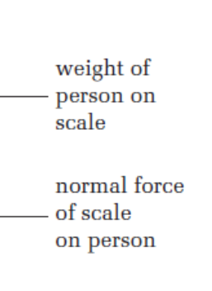
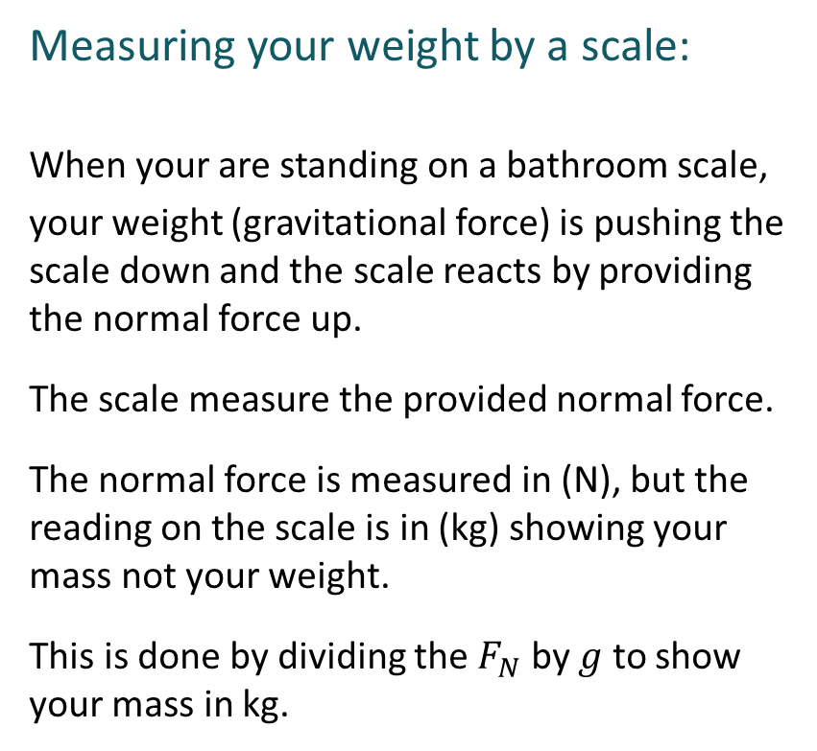


Measuring your weight by a scale:
When your are standing on a bathroom scale,
your weight (gravitational force) is pushing the scale down and the scale reacts by providing the normal force up.
The scale measure the provided normal force.
The normal force is measured in (N), but the reading on the scale is in (kg) showing your mass not your weight.
This is done by dividing the $F_{N}$ by $g$ to show your mass in kg.
$$F_{N}$$
m
$$F_{g}$$

Slide 3
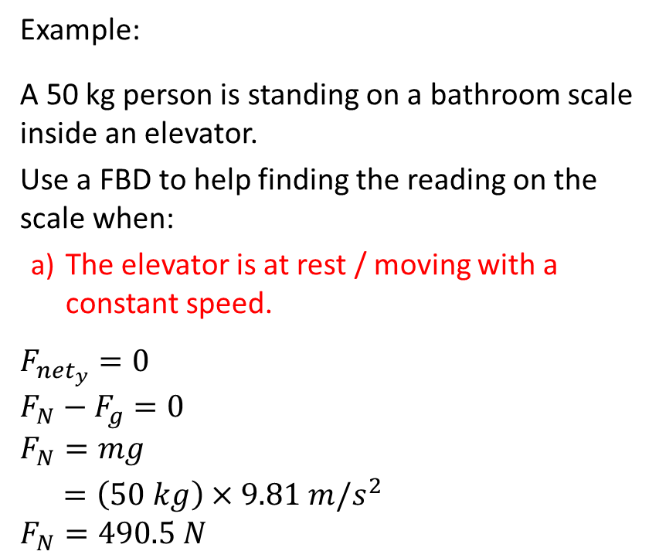


Example:
A 50 kg person is standing on a bathroom scale inside an elevator.
Use a FBD to help finding the reading on the scale when:
The elevator is at rest / moving with a constant speed.
$$F_{{net}_{y}}=0$$
$${F_{N}−F}_{g}=0$$
$$F_{N}=mg$$
$=\left(50 kg\right)×9.81 m/s^{2}$
$$F_{N}=490.5 N$$
$$F_{N}$$
50 kg
When the elevator is stationary or moving with constant velocity, you feel normal and the scale shows your actual mass.
$F_{g}$=mg

Slide 4
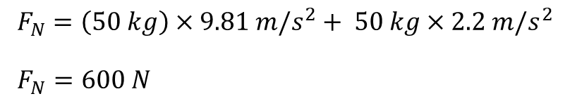


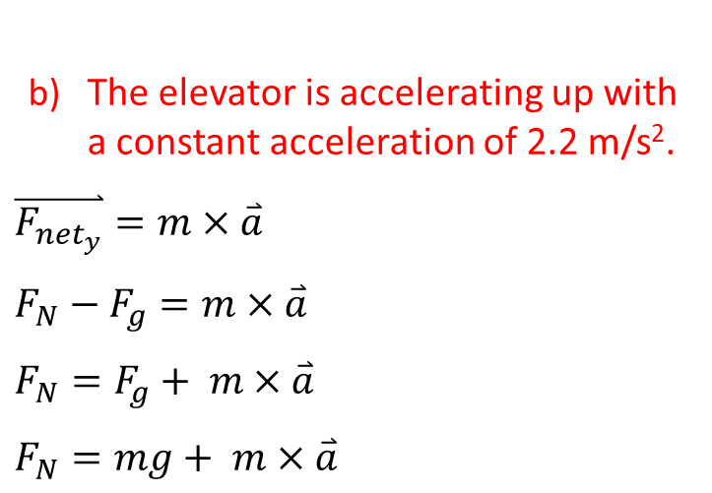


The elevator is accelerating up with a constant acceleration of 2.2 m/s².
$$\overset{⃑}{F_{{net}_{y}}}=m×\overset{⃑}{a}$$
$${F_{N}−F}_{g}=m×\overset{⃑}{a}$$
$$F_{N}=F_{g}+ m×\overset{⃑}{a}$$
$$F_{N}=mg+ m×\overset{⃑}{a}$$
$$\overset{⃑}{a}=2.2 m/s^{2}$$
$$F_{N}=\left(50 kg\right)×9.81 m/s^{2}+ 50 kg×2.2 m/s^{2}$$
$F_{N}=600 N$
$$F_{N}$$
When the elevator is accelerating up, you feel as your are heavier and the scale shows a higher reading than the actual mass.
50 kg
$$\overset{⃑}{a}=2.2 m/s^{2}$$
$F_{g}$=mg

Slide 5


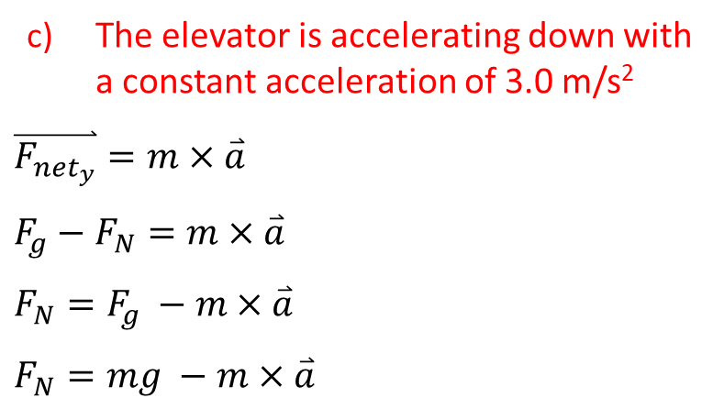
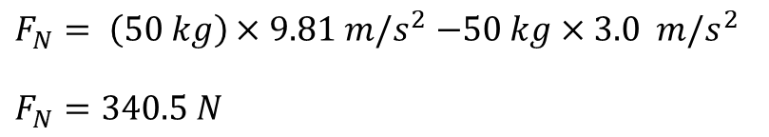
The elevator is accelerating down with a constant acceleration of 3.0 m/s²
$$\overset{⃑}{F_{{net}_{y}}}=m×\overset{⃑}{a}$$
$${F_{g}−F}_{N}=m×\overset{⃑}{a}$$
$$F_{N}=F_{g} −m×\overset{⃑}{a}$$
$$F_{N}=mg −m×\overset{⃑}{a}$$
$$\overset{⃑}{a}=3.0 m/s^{2}$$
$F_{N}= \left(50 kg\right)×9.81 m/s^{2}$ $−50 kg×3.0 m/s^{2}$
$$F_{N}=340.5 N$$
$$F_{N}$$
When the elevator is accelerating down, you feel as your are lighter and the scale shows a smaller reading than the actual mass.
50 kg
$$\overset{⃑}{a}=3.0 m/s^{2}$$
$F_{g}$=mg

Slide 6
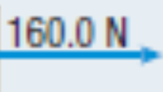

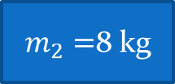





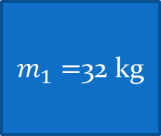

Example:
A worker pushes two large boxes across the floor with an applied force of 160.0 N [right] on the larger box and the boxes are touching. The mass of the larger box is m₁ = 32.0 kg and the mass of the smaller box is m₂ = 8.0 kg. If the coefficient of kinetic friction is 0.2;
(a) Calculate the acceleration of the two boxes.
$$F_{N_{1}}$$
$$F_{N_{2}}$$
To calculate the acceleration, you need to work on the whole system because the action and the reaction forces cancel each other in our calculations.
$$F_{f_{1}}$$
$$F_{a}=160 N$$
$m_{1}=$32 kg
$m_{2}=$8 kg
$$F_{f_{2}}$$
$$F_{g_{1}}$$
$$F_{g_{2}}$$

Slide 7



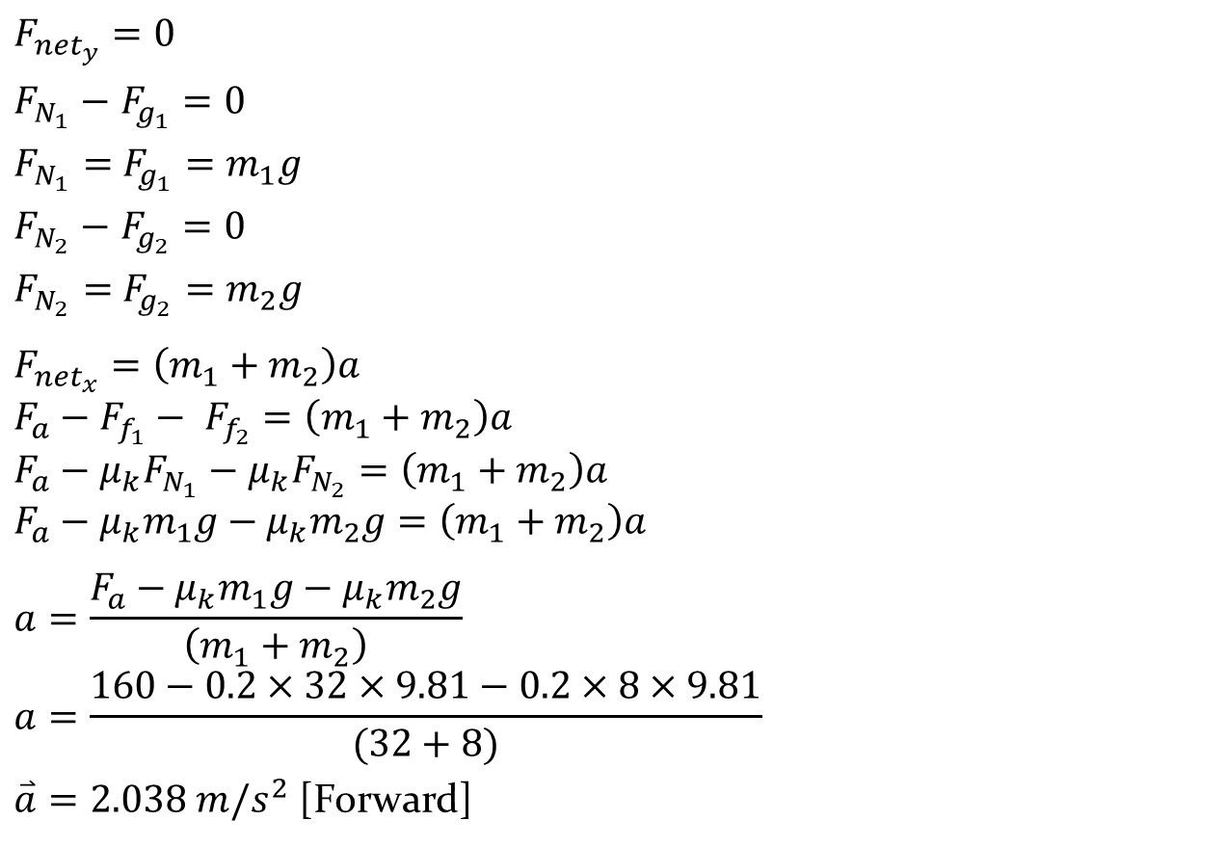






$$F_{N_{1}}$$
$$F_{N_{2}}$$
$$F_{{net}_{y}}=0$$
$F_{N_{1}}−$ $F_{g_{1}}=0$
$F_{N_{1}}=$ $F_{g_{1}}=m_{1}g$
$F_{N_{2}}−$ $F_{g_{2}}=0$
$F_{N_{2}}=$ $F_{g_{2}}=m_{2}g$
$$F_{{net}_{x}}=\left(m_{1}+m_{2}\right)a$$
$$F_{a}−F_{f_{1}}− F_{f_{2}}=\left(m_{1}+m_{2}\right)a$$
$$F_{a}−{μ_{k}F}_{N_{1}}−{μ_{k}F}_{N_{2}}=\left(m_{1}+m_{2}\right)a$$
$$F_{a}−{μ_{k}m}_{1}g−{μ_{k}m}_{2}g=\left(m_{1}+m_{2}\right)a$$
$$a=\frac{F_{a}−{μ_{k}m}_{1}g−{μ_{k}m}_{2}g}{\left(m_{1}+m_{2}\right)}$$
$$a=\frac{160−0.2×32×9.81−0.2×8×9.81}{(32+8)}$$
$\overset{⃑}{a}=2.038 m/s^{2}$ [Forward]
$$F_{f_{1}}$$
$$F_{a}=160 N$$
$m_{1}=$32 kg
$m_{2}=$8 kg
$$F_{f_{2}}$$
$$F_{g_{1}}$$
$$F_{g_{2}}$$

Slide 8



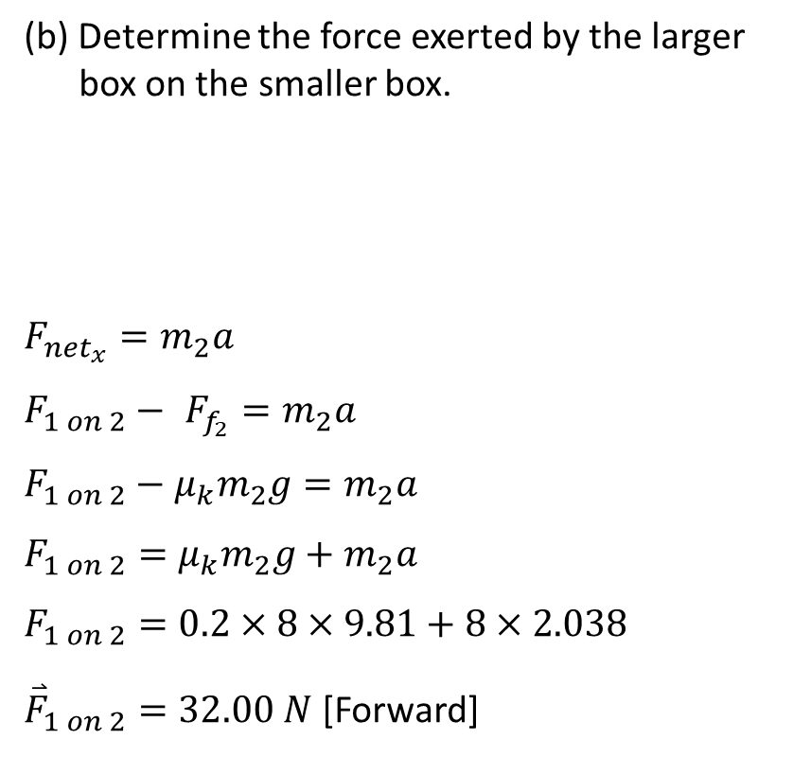



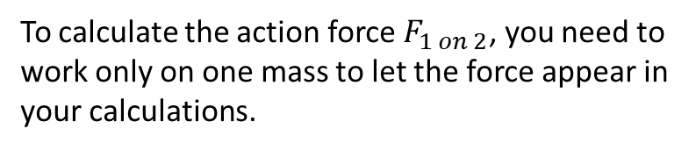
(b) Determine the force exerted by the larger box on the smaller box.
$$F_{{net}_{x}}=m_{2}a$$
$$F_{1 on 2}− F_{f_{2}}=m_{2}a$$
$$F_{1 on 2}−{μ_{k}m}_{2}g=m_{2}a$$
$$F_{1 on 2}={μ_{k}m}_{2}g+m_{2}a$$
$$F_{1 on 2}=0.2×8×9.81+8×2.038$$
${\overset{⃑}{F}}_{1 on 2}=32.00 N$ [Forward]
$$\overset{⃑}{a}=2.038 m/s^{2}$$
$$F_{N_{2}}$$
To calculate the action force $F_{1 on 2}$, you need to work only on one mass to let the force appear in your calculations.
$$F_{1 on 2}$$
$m_{2}=$8 kg
$$F_{f_{2}}$$
$$F_{g_{2}}$$

Slide 9



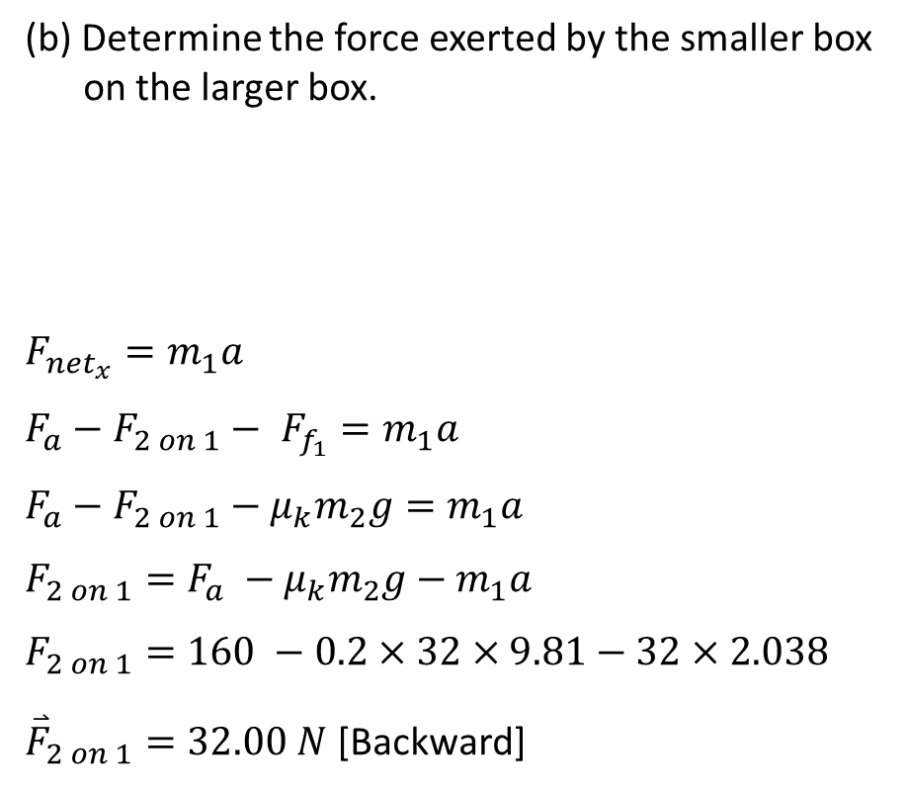


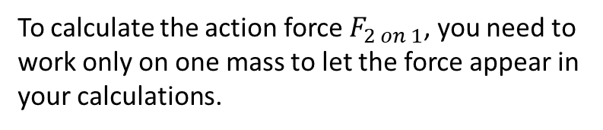


(b) Determine the force exerted by the smaller box on the larger box.
$$F_{{net}_{x}}=m_{1}a$$
$$F_{a}−F_{2 on 1}− F_{f_{1}}=m_{1}a$$
$$F_{a}−F_{2 on 1}−{μ_{k}m}_{2}g=m_{1}a$$
$$F_{2 on 1}={F_{a} −μ_{k}m}_{2}g−m_{1}a$$
$$F_{2 on 1}=160 −0.2×32×9.81−32×2.038$$
${\overset{⃑}{F}}_{2 on 1}=32.00 N$ [Backward]
$$\overset{⃑}{a}=2.038 m/s^{2}$$
$$F_{N_{1}}$$
To calculate the action force $F_{2 on 1}$, you need to work only on one mass to let the force appear in your calculations.
$$F_{f_{1}}$$
$m_{1}=$32 kg
$$F_{a}=160 N$$
$$F_{2 on 1}$$
$$F_{g_{1}}$$

Slide 10
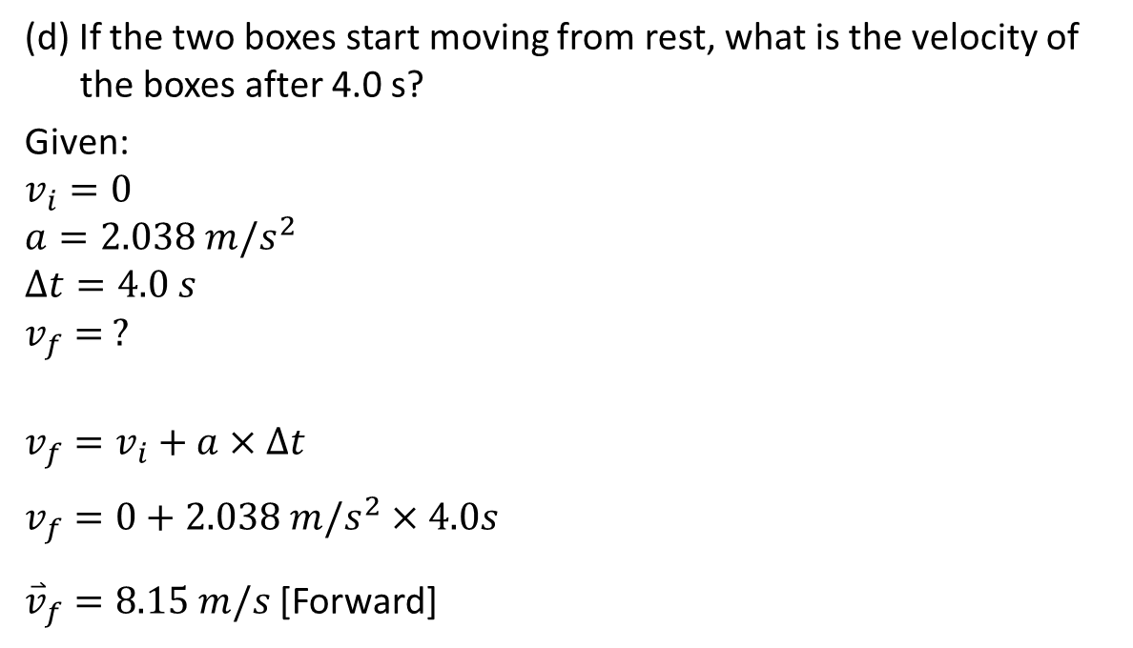
(d) If the two boxes start moving from rest, what is the velocity of the boxes after 4.0 s?
Given:
$$v_{i}=0$$
$$a=2.038 m/s^{2}$$
$$∆t=4.0 s$$
$$v_{f}= ?$$
$$v_{f}=v_{i}+a×∆t$$
$$v_{f}=0+2.038 m/s^{2}×4.0s$$
${\overset{⃑}{v}}_{f}=8.15 m/s$ [Forward]

Slide 11

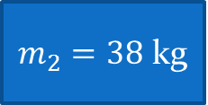

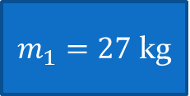





Example:
Two sleds are tied together with a rope. A small child is sitting on sled 1 (total mass of 27 kg) and a larger child sits on sled 2 (total mass of 38 kg). An adult pulls on the sleds.
(a) What is the greatest horizontal force that the adult can exert on sled 1 without moving either sled, if he coefficient of static friction between sleds and the snow is 0.22?
Trying to move
To calculate the acceleration, you need to work on the whole system because the action tension and the reaction tension cancel each other in our calculations.
$$F_{N_{2}}$$
$$F_{N_{1}}$$
$$F_{f_{1}}$$
$$F_{f_{2}}$$
$m_{2}=38$ kg
$m_{1}=27$ kg
$$F_{max}$$
T
T
$$F_{g_{2}}$$
$$F_{g_{1}}$$

Slide 12





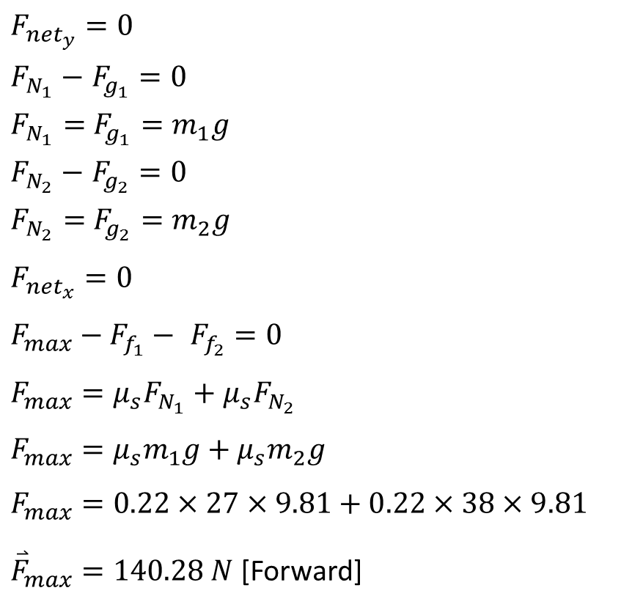




Trying to move
$$F_{{net}_{y}}=0$$
$F_{N_{1}}−$ $F_{g_{1}}=0$
$F_{N_{1}}=$ $F_{g_{1}}=m_{1}g$
$F_{N_{2}}−$ $F_{g_{2}}=0$
$F_{N_{2}}=$ $F_{g_{2}}=m_{2}g$
$$F_{{net}_{x}}=0$$
$$F_{max}−F_{f_{1}}− F_{f_{2}}=0$$
$$F_{max}={μ_{s}F}_{N_{1}}+{μ_{s}F}_{N_{2}}$$
$$F_{max}={μ_{s}m}_{1}g+{μ_{s}m}_{2}g$$
$$F_{max}=0.22×27×9.81+0.22×38×9.81$$
${\overset{⃑}{F}}_{max}=140.28 N$ [Forward]
$$F_{N_{2}}$$
$$F_{N_{1}}$$
$$F_{f_{1}}$$
$$F_{f_{2}}$$
$m_{2}=$38 kg
$m_{1}=27$ kg
$$F_{max}$$
T
T
$$F_{g_{2}}$$
$$F_{g_{1}}$$

Slide 13



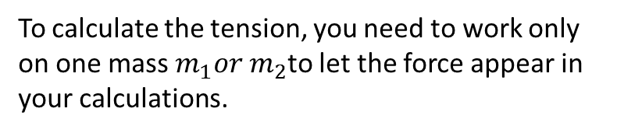


(b) Calculate the magnitude of the tension in the rope between sleds 1 and 2 when the adult exerts this greatest horizontal force.
To calculate the tension, you need to work only on one mass $m_{1}or m_{2}$to let the force appear in your calculations.
For $m_{2}:$
$$F_{{net}_{x}}=0$$
T$− F_{f_{2}}=0$
$$T= {μ_{s}m}_{2}g$$
T $=0.22×38×9.81$
$$T=82.01 N$$
Trying to move
$$F_{N_{2}}$$
$$F_{f_{2}}$$
$m_{2}=$38 kg
T
$$F_{g_{2}}$$

Slide 14


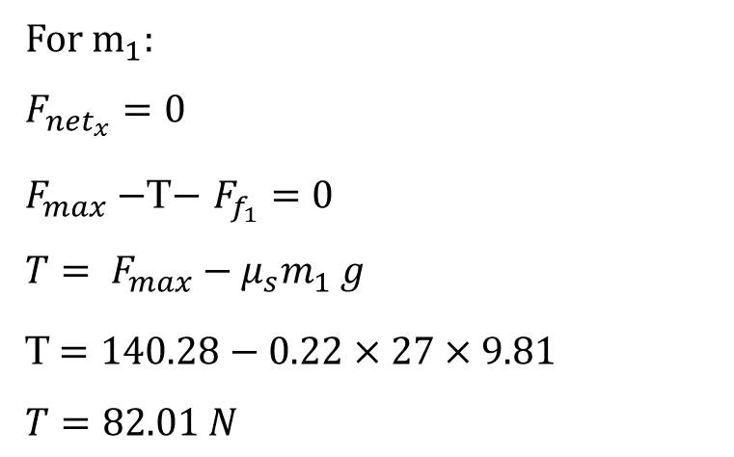



For $m_{1}:$
$$F_{{net}_{x}}=0$$
$F_{max}−$T$− F_{f_{1}}=0$
$$T= F_{max}{− μ_{s}m}_{1}g$$
T $=140.28−0.22×27×9.81$
$$T=82.01 N$$
Trying to move
$$F_{N_{1}}$$
$$F_{f_{1}}$$
$m_{1}=27$ kg
$$F_{max}$$
T
$$F_{g_{1}}$$

Slide 15
Example:
The cart in Figure 1 has a mass of 0.4 kg and is attached, by a string and a pulley, to a weight that has a mass of 0.20 kg.
(a) Calculate the acceleration of the cart and the mass together, if the kinetic coefficient of frictional between and the table and the cart is 0.12 .
To calculate the acceleration, you need to work on the whole system respecting the direction of motion is the positive direction so the action tension and the reaction tension cancel each other in our calculations.

Slide 16



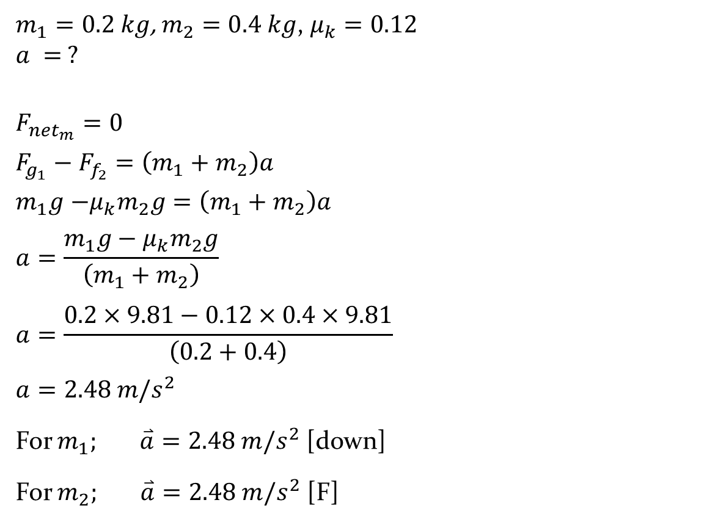



$m_{1}=0.2 kg$, $m_{2}=0.4 kg$, $μ_{k}=0.12$
$$a = ?$$
$$F_{{net}_{m}}=0$$
$F_{g_{1}}−$ $F_{f_{2}}=\left(m_{1}+m_{2}\right)a$
$m_{1}g$ $−{μ_{k}m}_{2}g=\left(m_{1}+m_{2}\right)a$
$$a=\frac{m_{1}g−{μ_{k}m}_{2}g}{\left(m_{1}+m_{2}\right)}$$
$$a=\frac{0.2×9.81−0.12×0.4×9.81}{\left(0.2+0.4\right)}$$
$$a=2.48 m/s^{2}$$
For $m_{1}; \overset{⃑}{a}=2.48 m/s^{2}$ [down]
For $m_{2}; \overset{⃑}{a}=2.48 m/s^{2}$ [F]
motion
$$F_{N_{2}}$$
$$F_{f_{2}}$$
T
$$m_{2}$$
T
$$F_{g_{2}}$$
$$m_{1}$$
motion
$$F_{g_{1}}$$

Slide 17

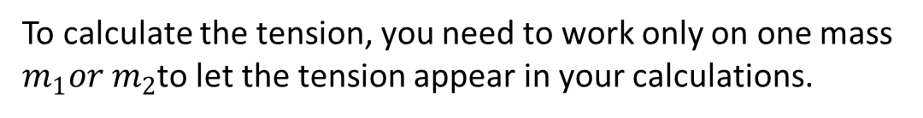


T
(b) Calculate the magnitude of the tension in the string.
To calculate the tension, you need to work only on one mass $m_{1}or m_{2}$to let the tension appear in your calculations.
$$m_{1}$$
motion
For $m_{1}:$
$$F_{{net}_{m}}=m_{1}a$$
$$F_{g_{1}}−T=m_{1}a$$
$$T =F_{g_{1}}− m_{1}a$$
$$T =m_{1}g− m_{1}a$$
$$T=0.2×9.81−0.2×2.48$$
$$T=1.47 N$$
$$F_{g_{1}}$$

Slide 18

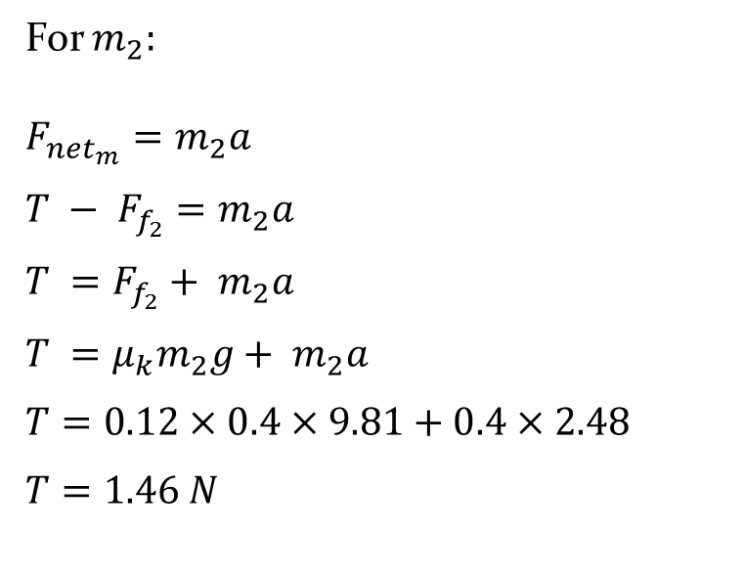



For $m_{2}:$
$$F_{{net}_{m}}=m_{2}a$$
$$T − F_{f_{2}}=m_{2}a$$
$$T =F_{f_{2}}+ m_{2}a$$
$$T ={μ_{k}m}_{2}g+ m_{2}a$$
$$T=0.12×0.4×9.81+0.4×2.48$$
$$T=1.46 N$$
motion
$$F_{N_{2}}$$
$$F_{f_{2}}$$
T
$$m_{2}$$
$$F_{g_{2}}$$
Practice questions on Pages 174, 175, 177, 178 of the textbook

Slide 19
Example:
An Atwood machine is made of two objects connected by a rope that runs over a pulley. The object on the left (m₁) has a mass of 8.5 kg and the object on the right (m₂) has a mass of 17 kg.
(a) What is the acceleration of the masses?

Slide 20
(b) What is the tension in the rope?

Slide 21
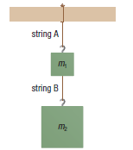
Example:
Two objects are hung from strings in the given Figure. The top object (m₁) is 12 kg and the bottom object (m₂) is 18 kg. Calculate the tension in each string.

Slide 22




Example:
A mass of 5 kg is hung from strings to the ceiling as it is in the given figure. Calculate the tension in each string.
Using Components:
Using Trigonometry:
$$60°$$
$$40°$$
$$T_{1}$$
$$T_{2}$$
5 kg

Slide 23
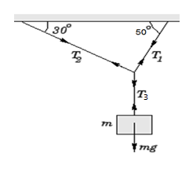
Example:
A mass of 8 kg is hung from strings to the ceiling as it is in the given figure. Calculate the tension in each string.

Slide 24
The tread on tires is designed to work under various road conditions.
Beneath the rubber tread are layers that
provide added safety and strength.
The piston pushes the brake
pads against the rotor, creating a force
of friction. The friction slows down the
wheel.
Questions # 32, 33, 34,37, 38, 41, 42, 46, 48, 49 of the package on pages 182-183
Questions # 1,2 on Page 144,
# 1, 2 on page 146, and
# 1-8 on page 147 of the textbook

